Slide 1

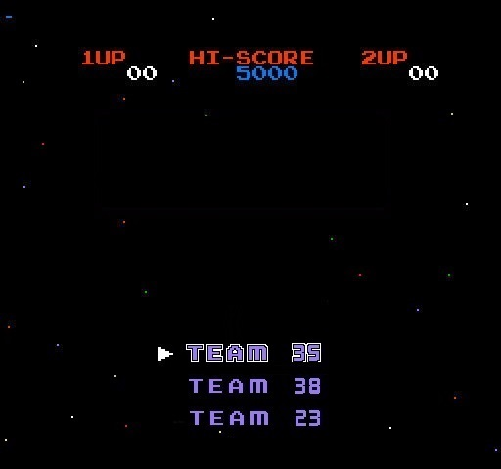

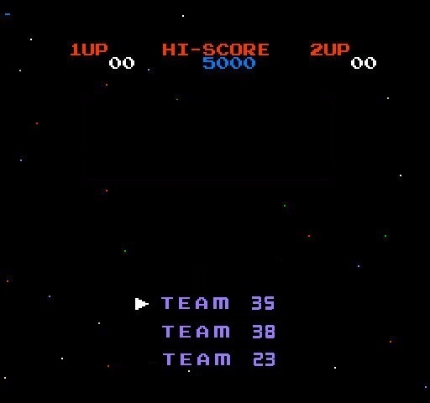


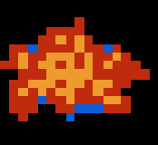


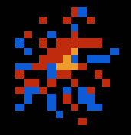



Slide 2

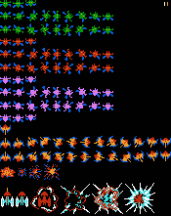
Outline
Team Roles
Members’ team roles allocation.
Proposed approach
How to develop this project, platform, language and library.
Technical analysis
Specific problems and solutions, technique point of developing.
Team skills
Why choose us? Our skills and experience.
Summary
What we have covered today.
“Galaxian outline”

Slide 3

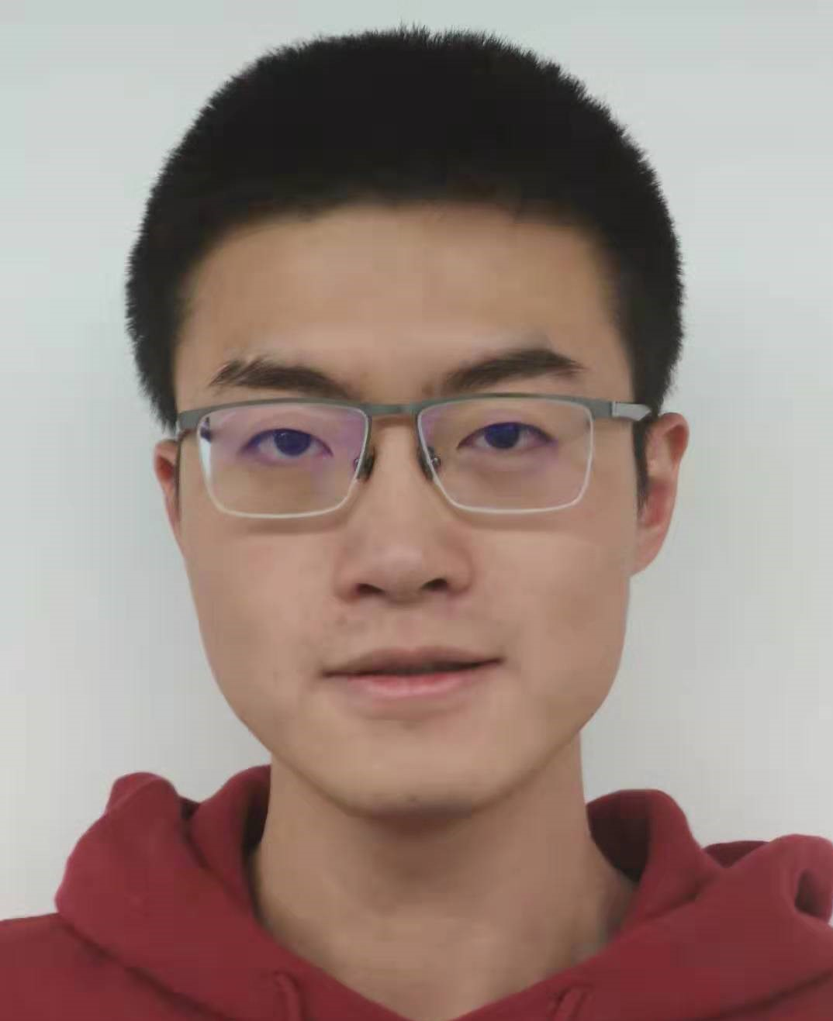
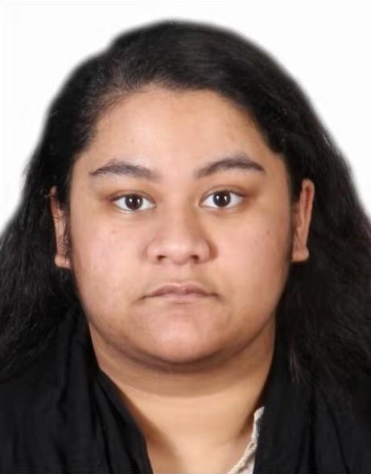
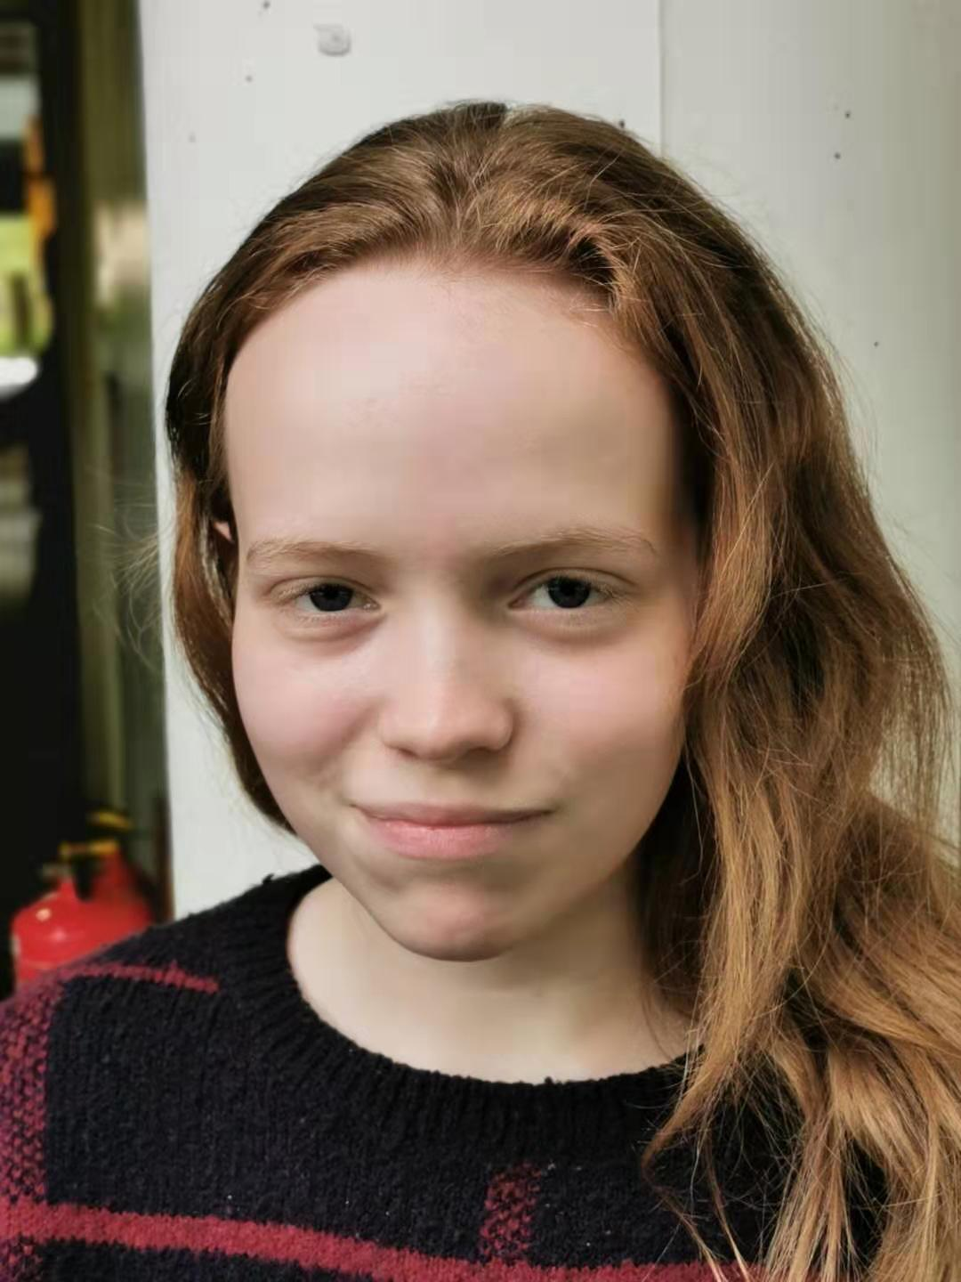
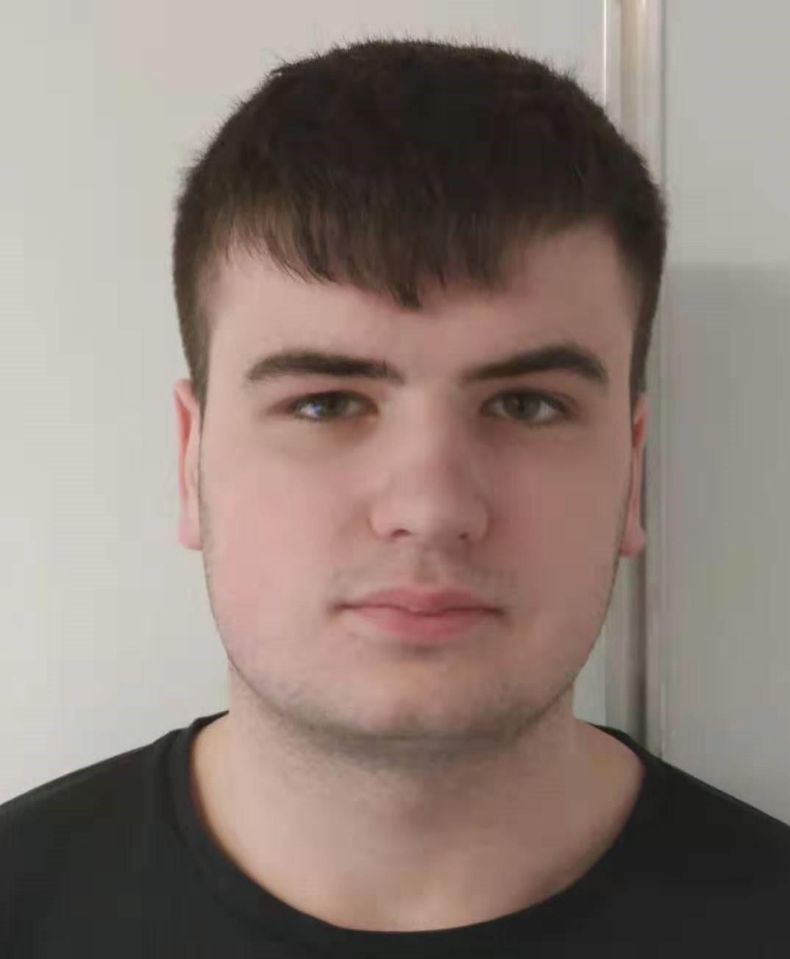

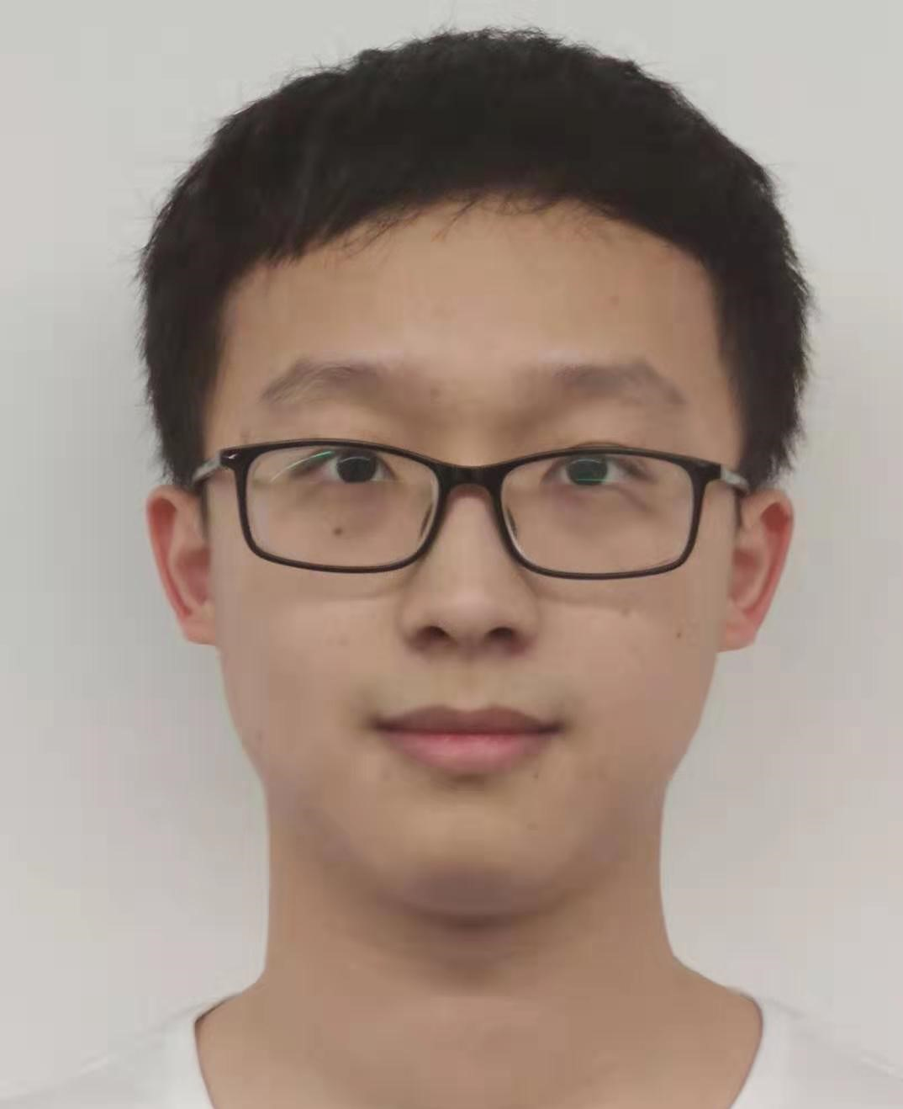
Team roles
Kejia Wu
Team Leader
Tasnuva Tajin
Nicole Millinship
Team Administrator
Liam Orrill
Gurjyot Kaur
Git Master
Xuanhao Li

Slide 4





Proposed approach
Programming platform ( Windows ):
Popular in our team;
Easy maintained.
Programming language ( C++ ):
High performance;
Stable in long-term operation;
Slightly challenging;
Java relies on libraries.
Libraries and reliance ( SFML ):
Convenient installation ( CMake );
Light, easy to learn ( SFML <=> GLFW );
Project requirement ( SFML <=> Qt / Unity ).

Slide 5
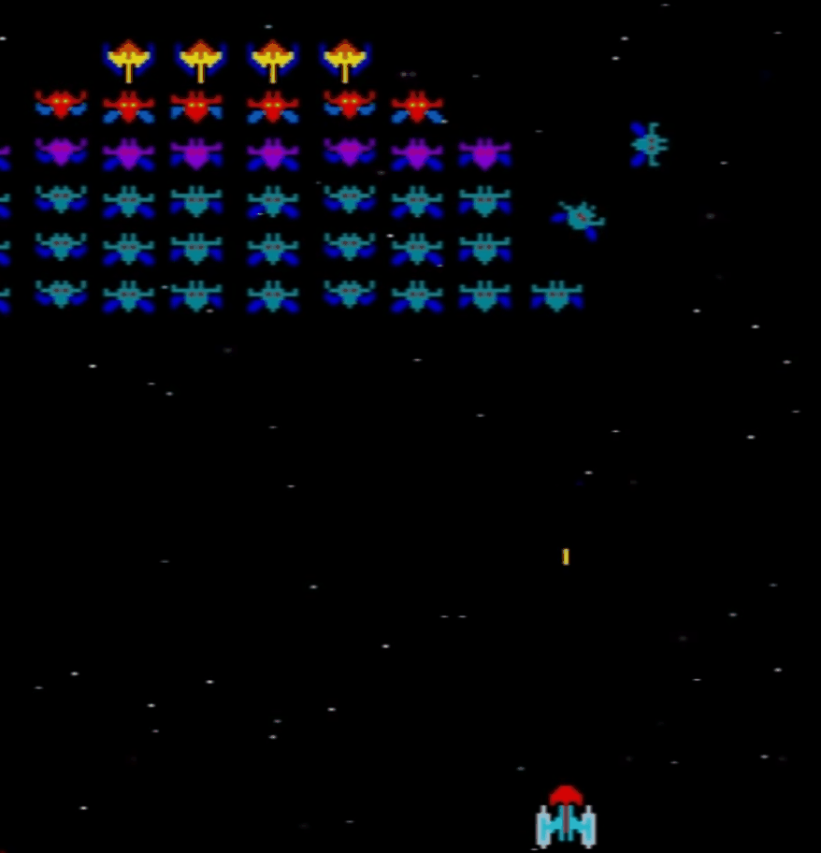
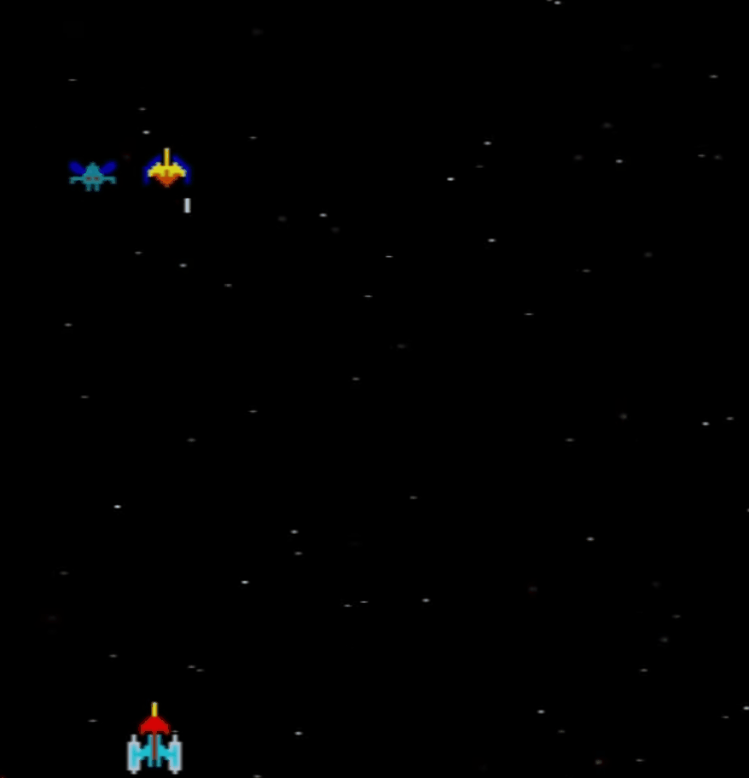
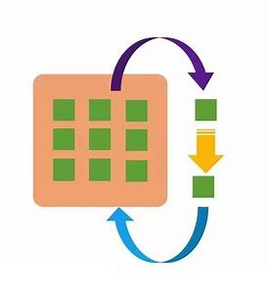

Technical analysis
Similarity:
Source researching ( Image & sounds );
Image construction ( Pixel conversion );
Image rotating;
Time intervals control.
Personal features:
Difficulty level ( more aspects );
Scoring system ( more options );
More enemy types ( proposed ).
Performance:
Background image;
Object managing ( Object Pool );
Multi-threads ( Pre-loading );
Pre-optimization is the root of evil.
Game platform
Object Pool

Slide 6
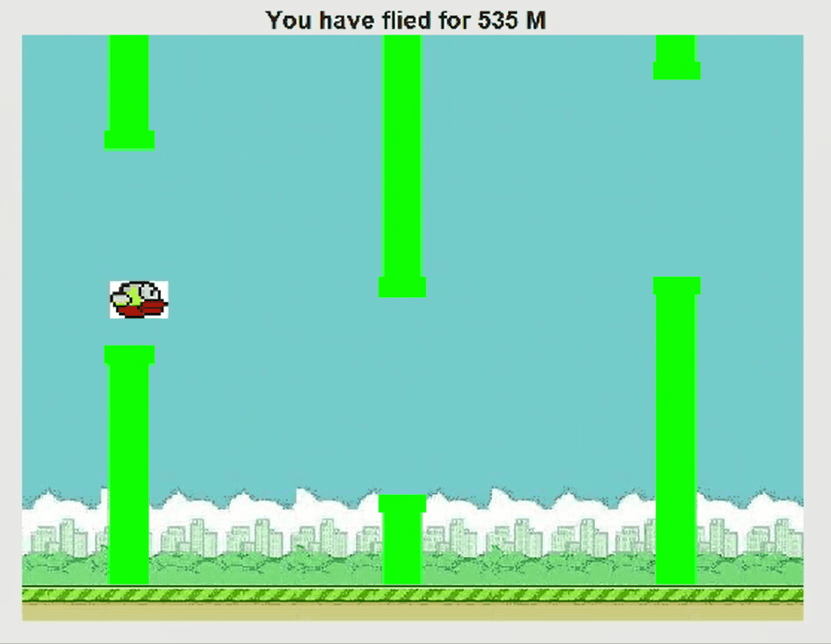
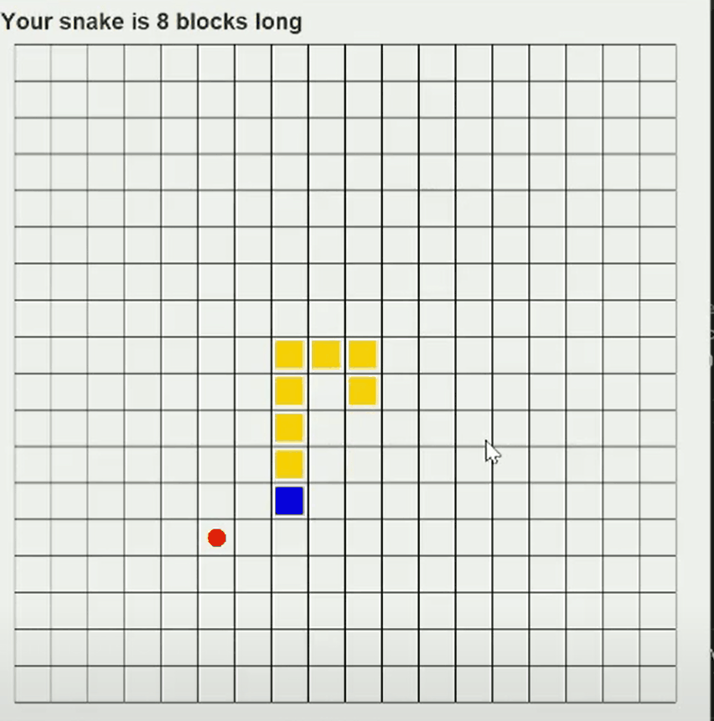
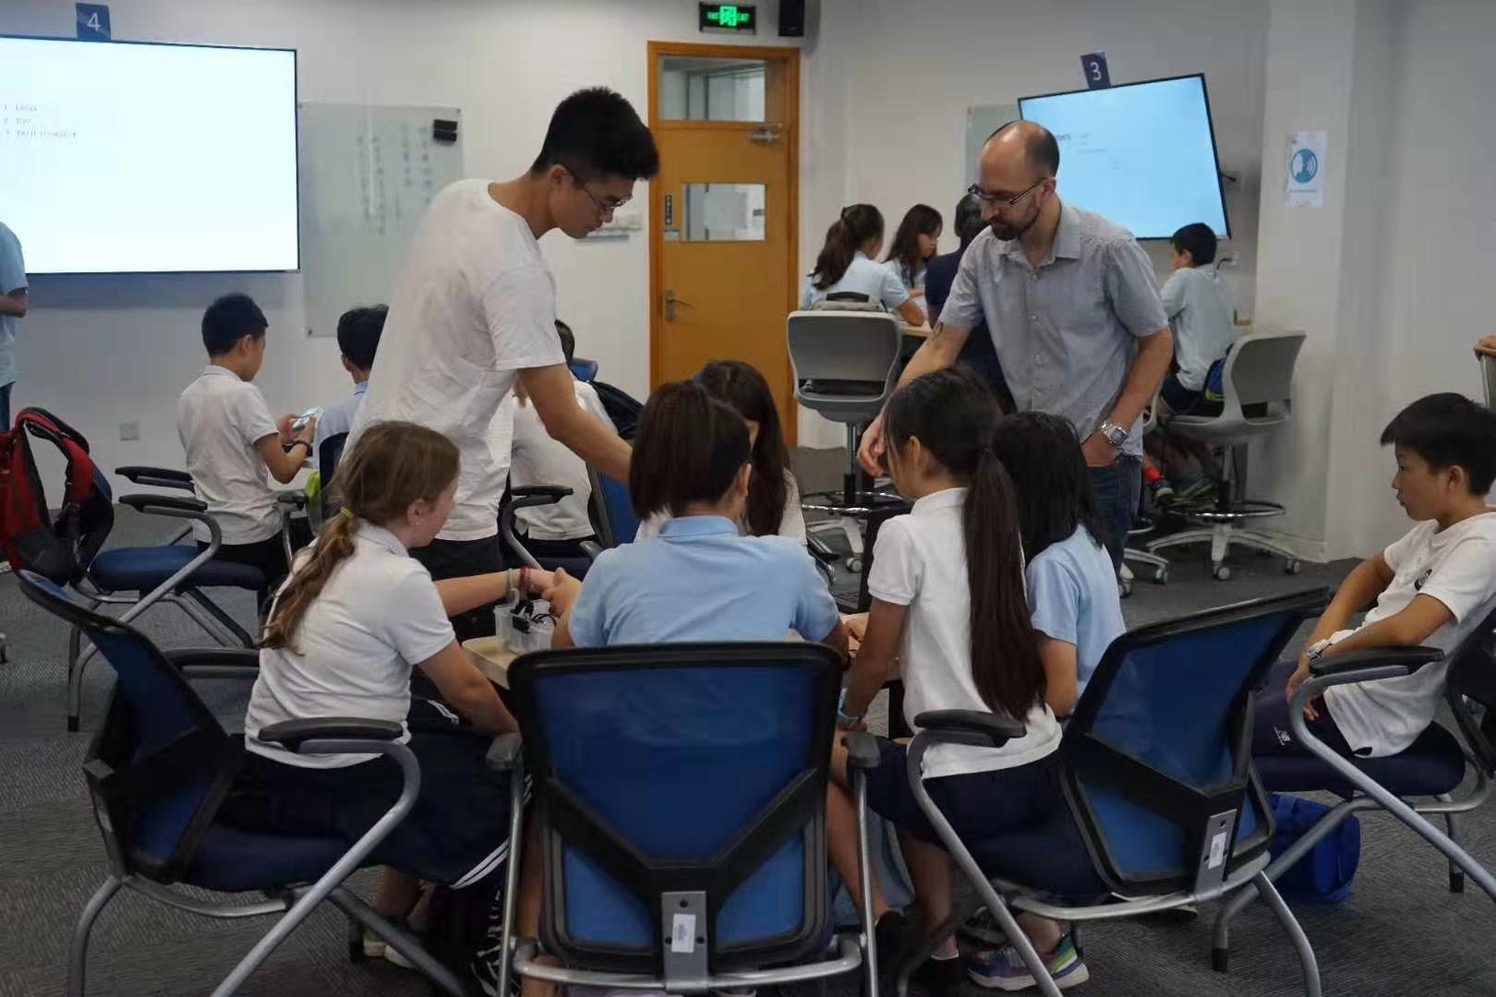
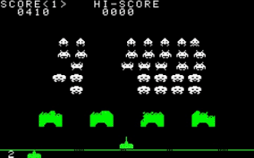
Team Skills
Game developing:
Kejia developed games in Java and C;
Gurjyot created Space Invaders style game;
Tajin programmed games in Java.
Team working:
Tajin works in IT service;
Liam joined university Ice Hockey team;
Kejia and Gurjyot worked in business company.
Interest in games:
Space Invader;
Game resource collection.

Slide 7
Summary
Our team proposed to implement this game in C++ and rely on SFML
Have collected great amount of image and sound source already
Analysis have been done to address specific problems
Experience in developing games without reliance on game engines
Good at team working and communication
Thank you for listening
Any questions?

